Slide 1

Capstone Project - The Battle of Neighborhoods (Week 2)

Slide 2
Toronto can be considered a home for many theatres and performing arts enthusiasts. According to Wikipedia, Toronto is the world's third largest centre for English-language theatre, home to venues like the Royal Alexandra Theatre, the oldest continuously operating theatre in North America. Besides that, Toronto is Canada’s largest media market, so any kind of interesting and unique art places can get exposure easily. Toronto is also a friendly city for foreigners as 47% of its population is made up of foreign-born persons. Meaning, it is a diverse city and has a lot of chances to introduce its culture to the world. Unfortunately, not many theatres are available in the borough of North York. With the vast changes of entertainment industry, people who invest in the business industries have the opportunities to build movie theatres in this borough.
INTRODUCTION

Slide 3
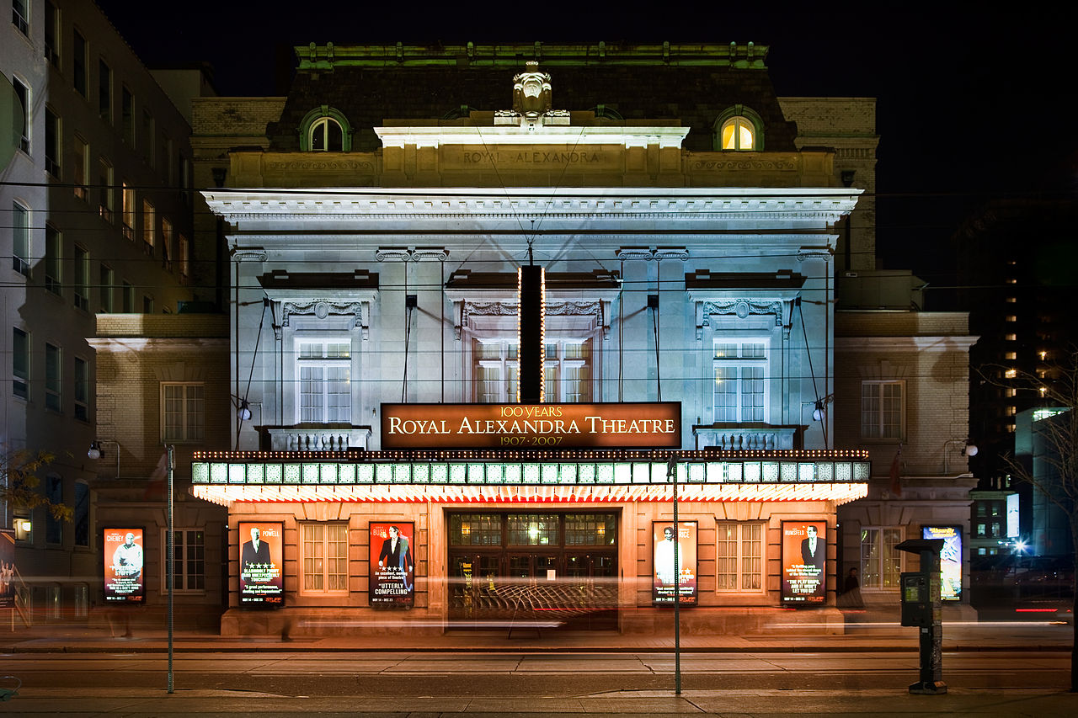
Toronto is the world's third largest centre for English-language theatre, home to venues like the Royal Alexandra Theatre, the oldest continuously operating theatre in North America

Slide 4
From the background, this project aims to answer these questions: 1. Which boroughs have movie theatre? 2. What is the best location in North York to build movie theatre?
PROBLEM

Slide 5
Data that will be used to solve the problem are: • Postal codes of Toronto, Ontario This data contains list of postal codes, boroughs and neighbourhoods of Toronto https://en.wikipedia.org/wiki/List_of_postal_codes_of_Canada • A Geographical coordinates data of each postal code http://cocl.us/Geospatial_data • A data that is already sliced to get North York dataframe This data will be extracted from the previous Notebook project. • Movie theatres in each neighbourhood of North York. This data will be extracted using Foursquare API.
DATA SECTION

Slide 6
The methods used in this project is first we find which neighbourhoods has movie theatres in North York. Then, we find the neighbourhoods with the most venue categories but doesn’t have movie theatre, as neighbourhoods with many attractions will attract people to go there. This can be done using the functions built in pandas. Then we validate our decision by using the Foursquare API to see top 5 venues in the chosen neighbourhoods and see if it will be supporting parameters to our decision.
METHODOLOGY

Slide 7
From the information, we can conclude that North York has only two movie theaters. This is a big opportunity to build movie theater in the borough. Although the parameter that will be considered here is we want to open movie theatre in a place where other top attractions exist, so the neighborhood that will be chosen is the one where most people will go. From the previous table, we can see that the neighborhoods with movie theaters are amongst the neighborhoods Fairview, Henry Farm, Oriole and Willowdale & Willowdale East. By this data, I choose to go with third most venue categories, which is neighbourhood Don Mills. Don Mills doesn't have a movie theatre, yet. From the Foursquare API it is found that in Don Mills the top 5 venue categories are Caribbean Restaurant, Café, Gym / Fitness Center, Japanese Restaurant, Baseball Field. These attractions will support the exposure of the movie theatre, as people who will go there will be driven by the fact that they can explore other venues around the movie theatre.
RESULTS

Slide 8
DISCUSSION From the observation, there are other parameters that can be considered for further analysis which are population, available areas, etc. CONCLUSION From the results we can conclude that Don Mills is the neighbourhood that can be chosen to build movie theatre.

